Slide 1
Software Construction
Evolution processes and activities

Slide 2
Introduction
The evolution process includes fundamental activities of change analysis, release planning, system implementation and releasing a system to customers. The cost an impact of these changes are accessed to see how much system is affected by the change and how much it might cost to implement the change.

Slide 3
Software change
Software change is inevitable:
New requirements emerge when the software is used
The business environment changes
Errors must be repaired
New computers and equipment are added to the system
The performance or reliability of the system may have to be improved
A key problem for all organizations is implementing and managing change to their existing software systems

Slide 4
Importance of evolution
Organizations have huge investments in their software systems - they are critical business assets.
To maintain the value of these assets to the business, they must be changed and updated.
The majority of the software budget in large companies is devoted to changing and evolving existing software rather than developing new software.

Slide 5
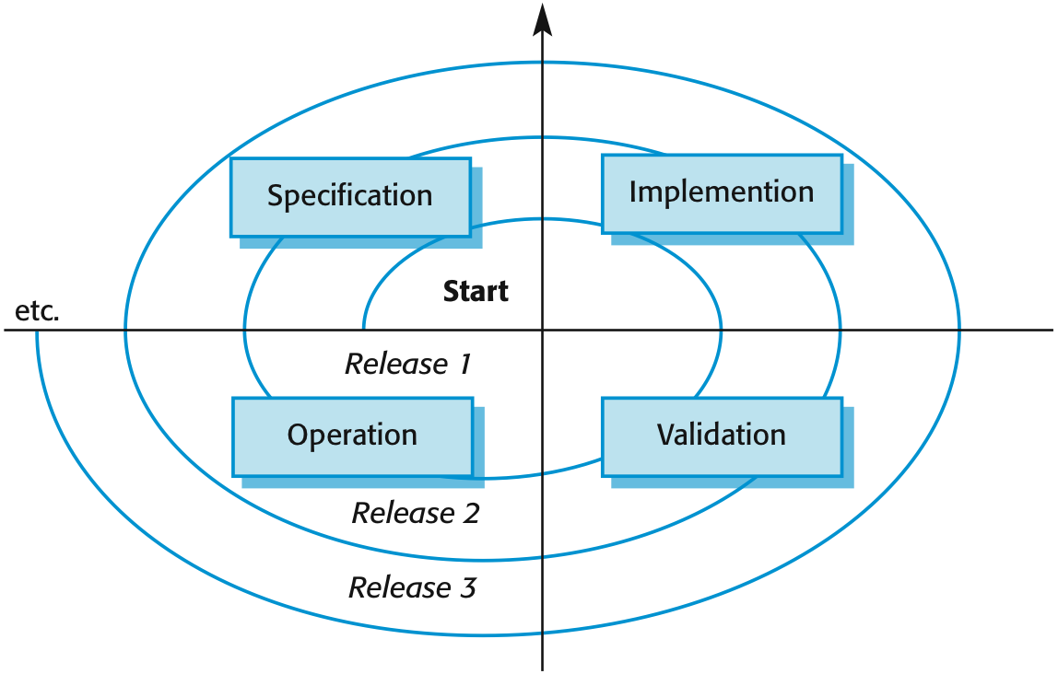
A spiral model of development and evolution

Slide 6
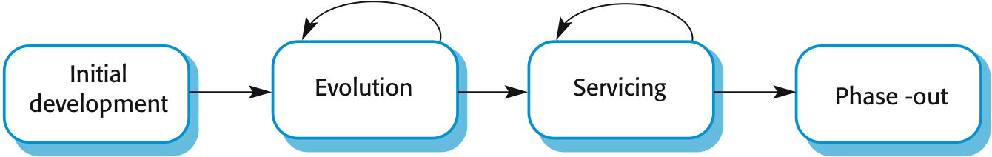
Evolution and servicing

Slide 7
Evolution and servicing
Evolution
The stage in a software system’s life cycle where it is in operational use and is evolving as new requirements are proposed and implemented in the system
Servicing
At this stage, the software remains useful but the only changes made are those required to keep it operational, i.e. bug fixes and changes to reflect changes in the software’s environment. No new functionality is added
Phase-out
The software may still be used but no further changes are made to it

Slide 8
Evolution processes
Software evolution processes depend on
The type of software being maintained
The development processes used
The skills and experience of the people involved
Proposals for change are the driver for system evolution
Should be linked with components that are affected by the change, thus allowing the cost and impact of the change to be estimated
Change identification and evolution continues throughout the system lifetime

Slide 9
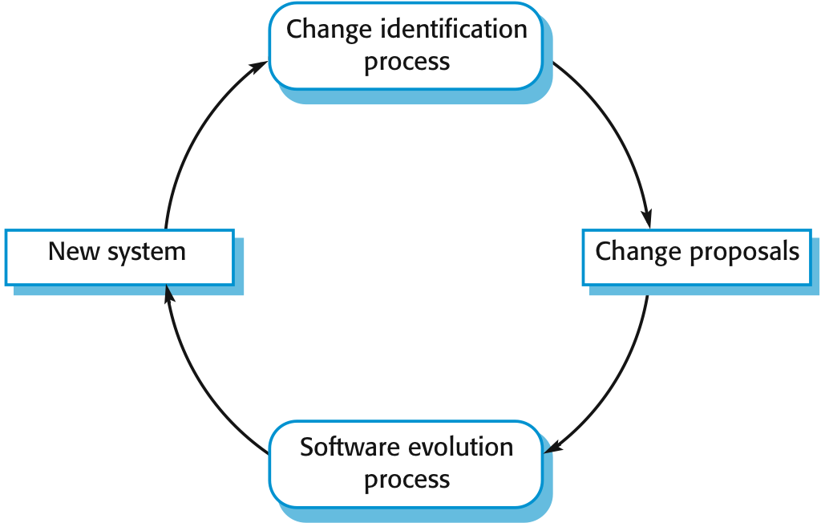
Change identification and evolution processes

Slide 10
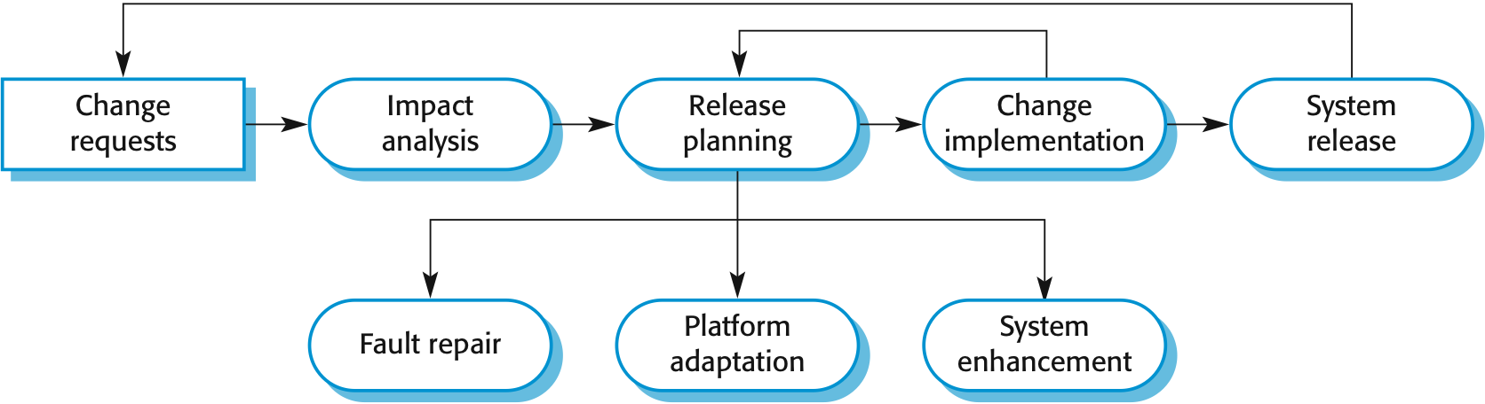
The software evolution process

Slide 11
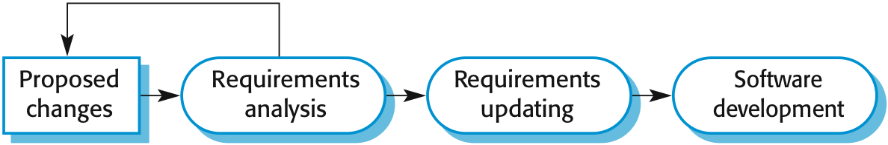
Change implementation

Slide 12
Change implementation
Iteration of the development process where the revisions to the system are designed, implemented and tested
A critical difference is that the first stage of change implementation may involve program understanding, especially if the original system developers are not responsible for the change implementation
During the program understanding phase, you have to understand how the program is structured, how it delivers functionality and how the proposed change might affect the program

Slide 13
Urgent change requests
Urgent changes may have to be implemented without going through all stages of the software engineering process
If a serious system fault has to be repaired to allow normal operation to continue
If changes to the system’s environment (e.g., an OS upgrade) have unexpected effects
If there are business changes that require a very rapid response (e.g. the release of a competing product)

Slide 14
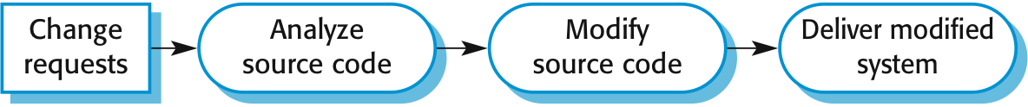
The emergency repair process

Slide 15
Software maintenance
Modifying a program after it has been put into use
The term is mostly used for changing custom software. Generic software products are said to evolve to create new versions.
Maintenance does not normally involve major changes to the system’s architecture
Changes are implemented by modifying existing components and adding new components to the system

Slide 16
Types of maintenance
Maintenance
Maintenance to repair software faults
Changing a system to correct deficiencies in the way meets its requirements
Maintenance to adapt software to a different operating environment
Changing a system so that it operates in a different environment (computer, OS, etc.) from its initial implementation
Maintenance to add to or modify the system’s functionality
Modifying the system to satisfy new requirements
Implement the program structure and system performance
Rewriting all or part of the system to make it more efficient and maintainable,
Evolution
Reengineering

Slide 17
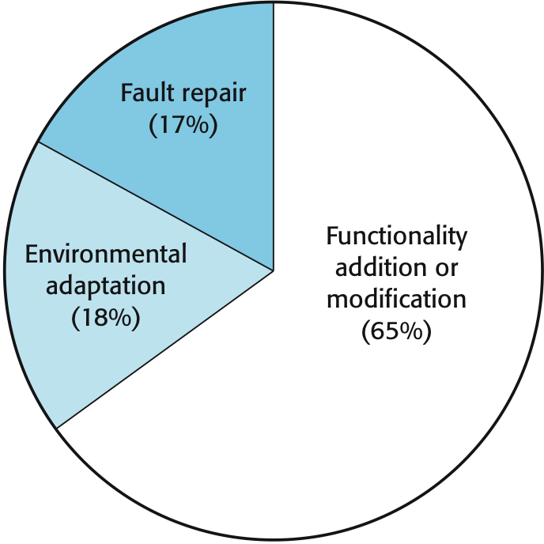
Maintenance effort distribution

Slide 18
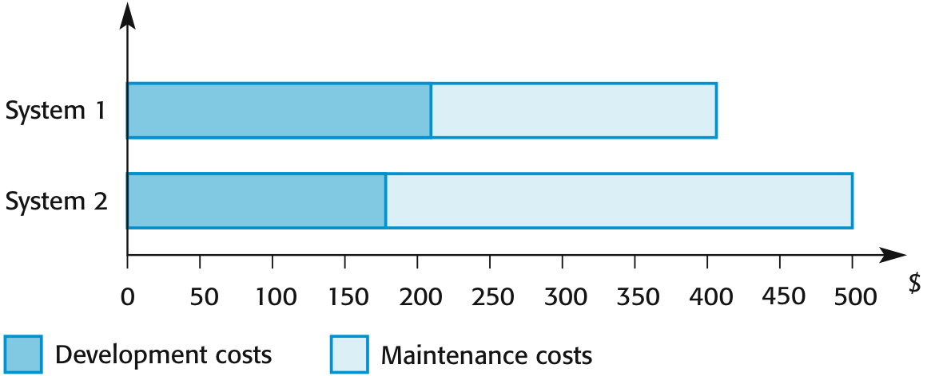
Development and maintenance costs

Slide 19
Maintenance cost factors
Team stability
Maintenance costs are reduced if the same staff are involved with them for some time
Contractual responsibility
The developers of a system may have no contractual responsibility for maintenance so there is no incentive to design for future change
Staff skills
Maintenance staff are often inexperienced and have limited domain knowledge
Program age and structure
As programs age, their structure is degraded and they become harder to understand and change

Slide 20
Maintenance prediction
Maintenance prediction is concerned with assessing which parts of the system may cause problems and have high maintenance costs
Change acceptance depends on the maintainability of the components affected by the change
Implementing changes degrades the system and reduces its maintainability
Maintenance costs depend on the number of changes and costs of change depend on maintainability

Slide 21
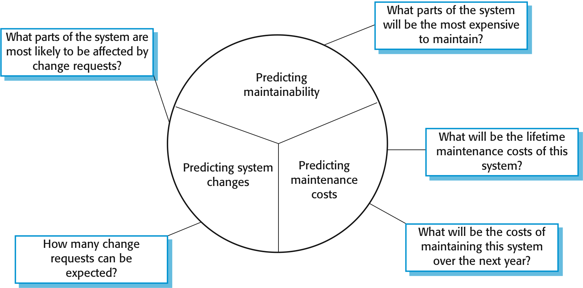
Maintenance prediction

Slide 22
Complexity metrics
Predictions of maintainability can be made by assessing the complexity of system components
Studies have shown that most maintenance effort is spent on a relatively small number of system components
Complexity depends on
Complexity of control structures
Complexity of data structures
Object, method (procedure) and module size

Slide 23
Process metrics
Process metrics may be used to assess maintainability
Number of requests for corrective maintenance
Average time required for impact analysis
Average time taken to implement a change request
Number of outstanding change requests
If any or all of these is increasing, this may indicate a decline in maintainability

Slide 24
System re-engineering
Re-structuring or re-writing part or all of a legacy system without changing its functionality
Applicable where some but not all sub-systems of a larger system require frequent maintenance
Re-engineering involves adding effort to make them easier to maintain. The system may be re-structured and re-documented.

Slide 25
Advantages of reengineering
Reduced risk
There is a high risk in new software development. There may be development problems, staffing problems and specification problems.
Reduced cost
The cost of re-engineering is often significantly less than the costs of developing new software.

Slide 26
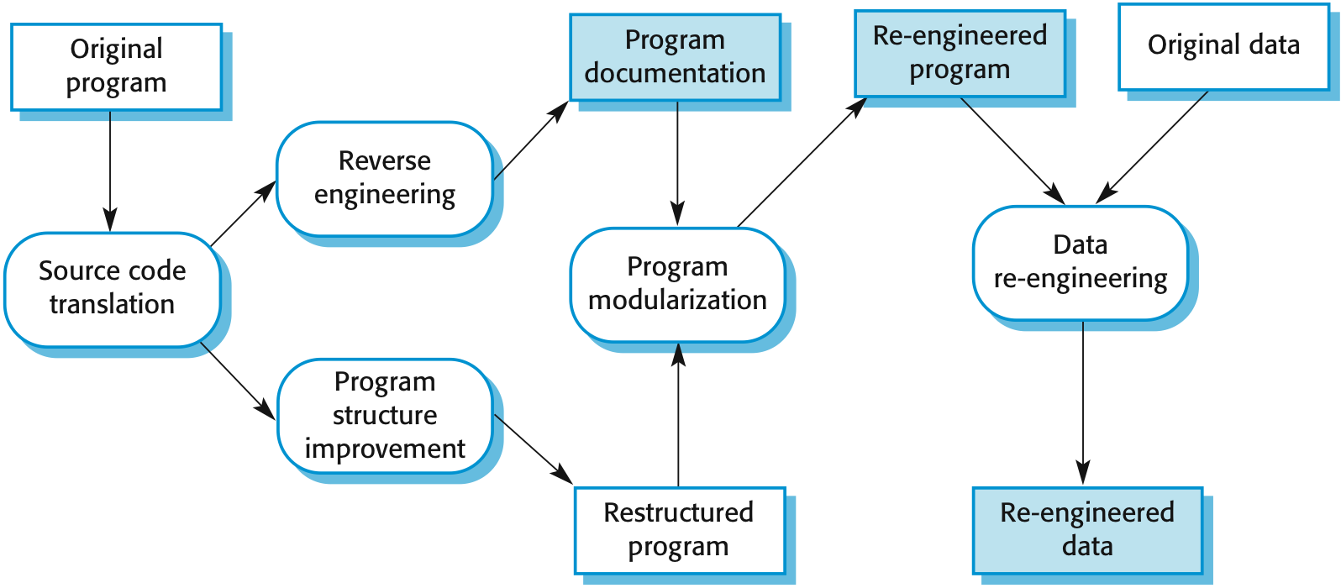
The reengineering process

Slide 27
Reengineering process activities
Source code translation
Convert code to a new language
Reverse engineering
Analyze the program to understand it
Program structure improvement
Restructure automatically for understandability
Program modularization
Reorganize the program structure
Data reengineering
Clean-up and restructure system data

Slide 28
Reengineering cost factors
The quality of the software to be reengineered
The tool support available for reengineering
The extent of the data conversion which is required
The availability of expert staff for reengineering
This can be a problem with old systems based on technology that is no longer widely used

Slide 29
Preventive maintenance by refactoring
Refactoring is the process of making improvements to a program to slow down degradation through change.
You can think of refactoring as ‘preventive maintenance’ that reduces the problems of future change
Refactoring involves modifying a program to improve its structure, reduce its complexity or make it easier to understand
When you refactor a program, you should not add functionality but rather concentrate on program improvement

Slide 30
Refactoring and reengineering
Re-engineering takes place after a system has been maintained for some time and maintenance costs are increasing. You use automated tools to process and re-engineer a legacy system to create a new system that is more maintainable.
Refactoring is a continuous process of improvement throughout the development and evolution process. It is intended to avoid the structure and code degradation that increases the costs and difficulties of maintaining a system.

Slide 31
Key points
Software development and evolution can be thought of as an integrated, iterative process that can be represented using a spiral model
For custom systems, the costs of software maintenance usually exceed the software development costs
The process of software evolution is driven by requests for changes and includes change impact analysis, release planning and change implementation

Slide 32
Key points
There are 3 types of software maintenance, namely bug fixing, modifying software to work in a new environment, and implementing new or changed requirements
Software re-engineering is concerned with re-structuring and re-documenting software to make it easier to understand and change
Refactoring, making program changes that preserve functionality, is a form of preventative maintenance.

